Slide 1
Growing agritech and foodtech in Hong Kong
Alice Tsang
Principal Economist (Global Research)
HKTDC Research
6 May 2025

Slide 2
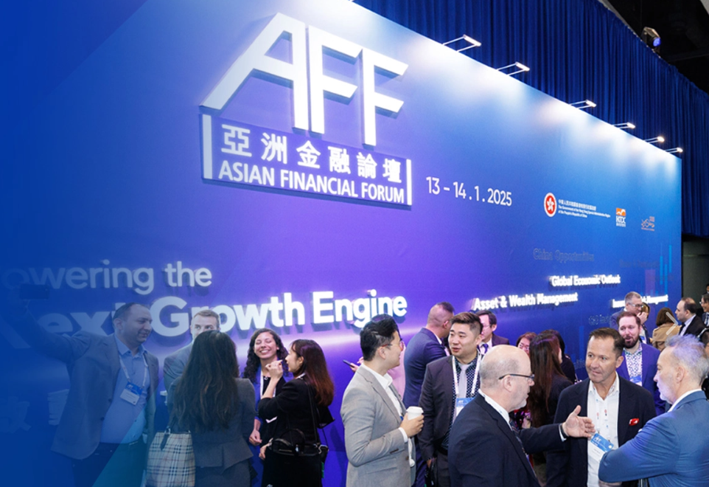
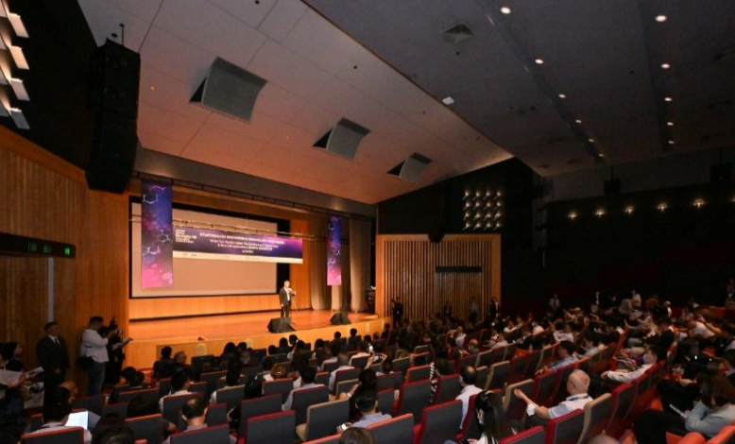
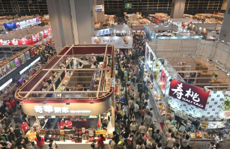
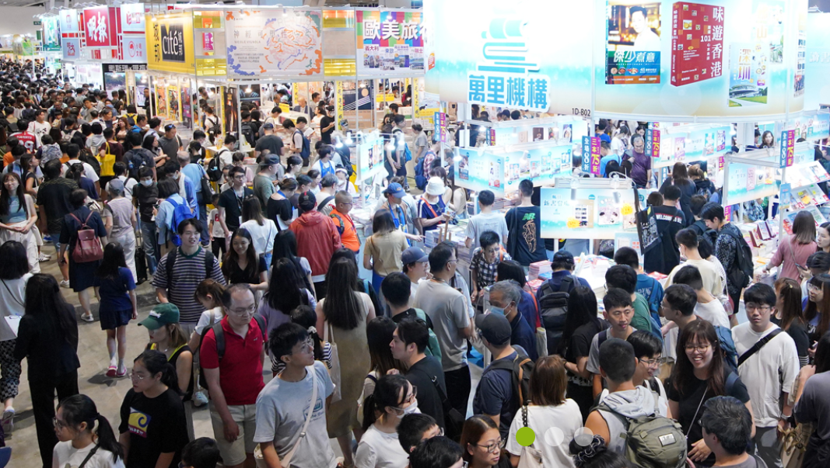
Who are we?
HKTDC is a statutory body established in 1966 to promote, assist and develop Hong Kong's trade.
The HKTDC promotes Hong Kong as a two-way global investment and business hub.
The HKTDC organises international exhibitions, conferences and business missions to create business opportunities for companies, particularly SMEs, in the mainland and international markets.

Slide 3
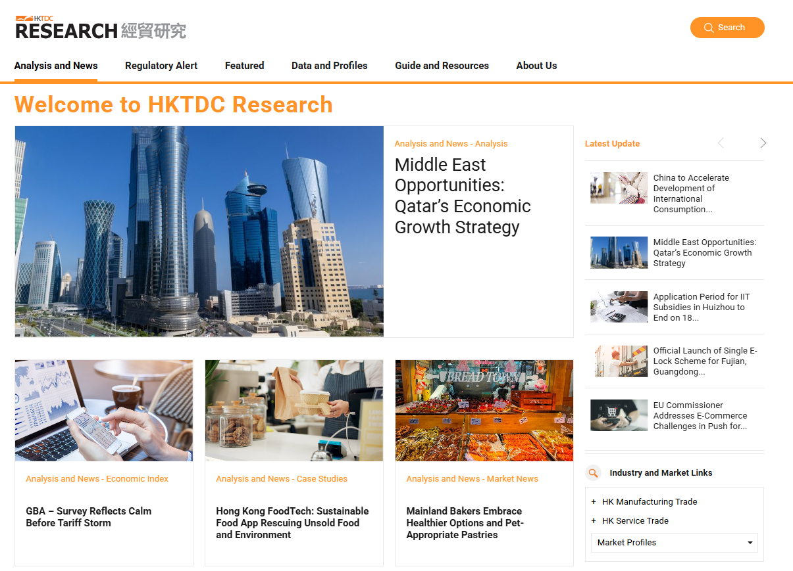
HKTDC Research
Provide analysis and news, regulatory alerts, market and industry profiles and business guides.
Thematic articles to facilitate access to today’s vibrant markets and on trending topics are published year-round.
Produce the quarterly HKTDC Export Index to gauge near-term export prospects.

Slide 4
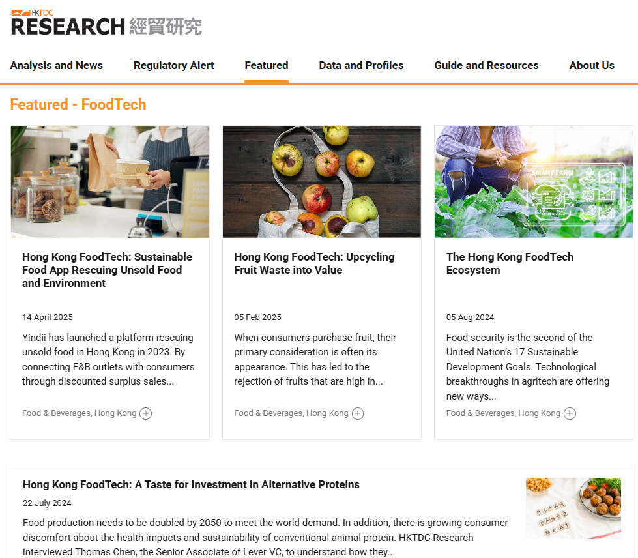
Research objectives of Hong Kong’s foodtech
Fortify the competitiveness of Hong Kong via innovation and embracing sustainable development
Cultivate strategic partnership with global accelerators with a focus on agritech and foodtech
Highlight Hong Kong’s role as a business hub for sustainability in the new economy

Slide 5
Foodtech Development

Slide 6
Agritech vs foodtech
Agriculture Technology
Food Technology
Technologies to increase the productivity and profitability of farming yields.
Seed science: plant breeding, genetic modifications
Farming additives: fertilisers, pesticides
Farming methods: conventional farming, greenhouses, hydroponics
Agriculture information science: precision farming with GPS and sensors
Technologies to improve the processing, storage, logistics, sales and safety of food.
Food production and processing
Nutrition science: enhance the added value of food
Supply chain of food: the logistics and sales of food
Food safety: testing, certification and labelling of food
Source: Interview with Prof Lam Hon-ming, HKTDC Research.

Slide 7
Why foodtech is getting more attention?
1) Climate change and food security
2) Supply chain disruptions
The food sector is calling for innovation because it accounts for 1/3 of all carbon emissions.
Global population is also set to reach 10 billion in 2050, but resources for food production are limited.
Climate change leads to prolonged dry spells and floods, damaging crops and the food supply chain.
Geopolitical tensions will disrupt the international trade, thus increasing food price and threaten food supply.
3) Global focus on UNSDGs
4) Rise of venture capital funds
UN’s emphasis on sustainability led to heightened attention on food security and climate change, attracting more investments and research on the topic.
The attention of VC firms in agri-foodtech since 2012 created a multiplier effect – more start-ups entered the sector, attracting even more VC investments.

Slide 8
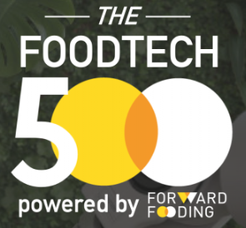
The trend of global agri-foodtech
Growth of the segment
The amount of money invest into Agri-foodtech start-ups had dropped from the peak of USD53.2 bn in 2021 to USD 15.6 bn in 2023
Sub-sectors
Forward Fooding, a European research institute creates a top-500 ranking of international agri-foodtech start-ups every year. They identified eight types of agri-foodtech:
Agtech
Food processing
Kitchen and restaurant tech
Food safety and traceability
Next-gen food and drinks
Food delivery
Consumer apps and services
Surplus & waste management
Source: AgFunder Global AgriFoodTech Investment Report 2024; https://forwardfooding.com/what-is-food-tech/

Slide 9
Foodtech ecosystem in Hong Kong
Six key stakeholders continue to shape the development of agri-foodtech in Hong Kong.
Start-ups
Commercialise technologies and tackle food issues
Traditional corporates
Adopt the new solutions provided by start-ups
Accelerators
Provide support services and network to help start-ups
VC funds
Provide capital for start-ups to grow their business
Media
Publicise and act as a networking hub for start-ups
Researchers
Advise on the technical feasibility of start-up’s solutions

Slide 10
Number of Foodtech Startups in Hong Kong
Source: InvestHK’s Startup Survey

Slide 11
In-depth case studies

Slide 12
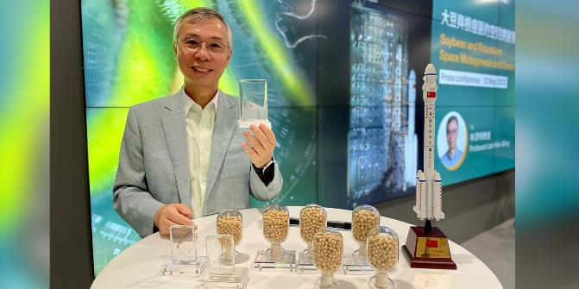
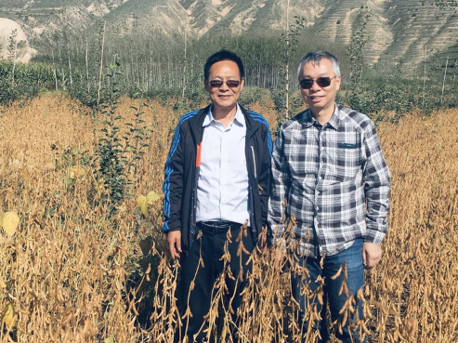
The Chinese University of Hong Kong
- Centre for Soybean Research
Successfully discovered the gene for salinity and drought tolerant soybeans
Collaboration with Chinese Gansu and Pakistan farmers to test out salinity and drought tolerant soybeans, which successfully increase productivity
Future research direction: discover more genes for ideal traits to tolerate extreme weather or climate changes

Slide 13
Hong Kong’s future direction
How Hong Kong can be involved in agrifood tech development: 1) core technology and new products development , 2) financing platform, 3) branding, 4) safety and quality certification
Hong Kong’s advantages in developing agritech and foodtech: 1) huge market potential in the mainland, 2) availability of farmland in the mainland for mass production opportunities, 3) talents
If Hong Kong would like to develop agrifood tech, more strategic policy direction or support is needed to be appealing for long-term investment
Hong Kong academic institutions have strong research backgrounds and skills, but lack investment or channels to package the core technology for commercialisation

Slide 14
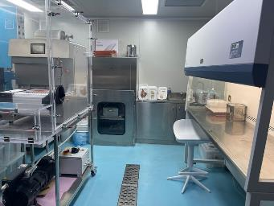
A Hong Kong foodtech company
- extend shelf life of cooked food
The company founded in 2016 in Hong Kong
A combination of three techniques:
1) high‑temperature short‑time pasteurisation
2) low‑temperature sous‑vide cooking
3) aseptic packaging
Allows food to be stored at room temperature for 2 years, without losing its nutritional value and without the use of chemicals or preservatives
Reducing energy consumption and lowering the costs of refrigerated transport and storage
Applying for patents in the US, the EU, mainland China and Hong Kong

Slide 15
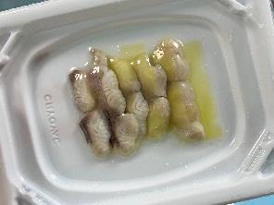
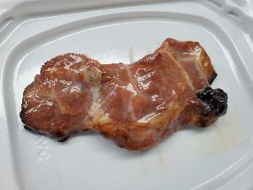
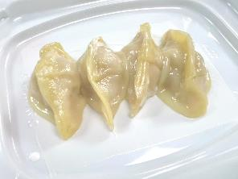
Advanced sous-vide aseptic packaging (ASAP)
Different kinds of food products have different attributes, such as their water activity, pH and texture.
Constantly fine-tune and validate the method and formula of processing the food ingredients
Targeted business partner: a shift from overseas meat producers to prepared food producers that require refrigerated storage
Enormous potential for growth in the ready‑to‑eat meals market, for instance: estimated size of the ready-to-eat meals market in China will be bigger than RMB1 trillion by 2026

Slide 16
Upcycling fruit waste into value
Fruits with defects in their appearance often end up in the landfill
Common freeze-drying technology to process unappealing fruits, which can be used as raw materials for secondary production
Innovative model: increasing the value of fruit waste and its products by enhancing their taste, nutritional value and convenience
Use freeze‑drying technology to freeze dry discarded fruits, extract their water content, grind the remainder into powder, then seal and package the end product

Slide 17
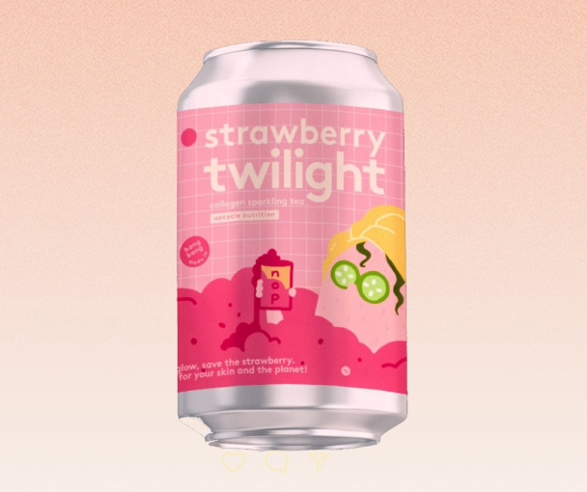
Superfoods to meet the market demand
Developed a fruit powder known as ‘fruitthies’, just add water or milk and become a tasty and healthy drink
Upgrade value by adding superfoods ingredients such as chia seeds
Newly launched earl grey tea with fresh strawberries and collagen
Marketing strategy: organise corporate workshops and apply SGS testing certificate to gain consumer confidence
On the list of 2024 funded projects under the HKEX Impact Funding Scheme

Slide 18
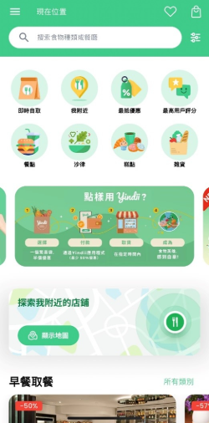
Sustainable food app rescuing unsold food
A Singaporean-based food startup founded in 2020, expanded its operation to Hong Kong in 2023
Hong Kong discards 1.3 million tonnes of food waste annually, 40% of it from restaurants, bakeries and supermarkets
This app empowering businesses to fight food waste making surplus food accessible to consumers at an affordable price
A win‑win‑win solution: businesses cut down on waste, customers access quality food at lower prices and the environment benefits from reduced emissions

Slide 19
Market selection criteria
High-density urban areas with strong concentration of F&B businesses
Eco-conscious consumer base: receptiveness to sustainability initiatives
Businesses: showcasing ESG initiatives to investors and the public
Customers: purchase quality food while saving money on their food bills
Future development:
AI‑driven stock prediction to help merchants optimise production and reduce food waste at the source
Dynamic pricing model to adjust prices in real‑time based on demand, time of day and remaining stock

Slide 20
Way forward
In order to drive the development of foodtech in Hong Kong, it is crucial that long‑term policies are devised and put in place.
Innovative technologies and novel solutions/products can also be transferred and applied in different markets
By strengthening the partnerships between the industry, academia and research sectors, and enhancing the vitality of various stakeholders in the foodtech ecosystem, the potential of Hong Kong foodtech industry is set to flourish.

